Slide 1
“BIKE BOULEVARDS” IN LAWRENCE Prepared 4/17/20
Healthy Built Environment Work Group

Slide 2
Why a “bike boulevard on 21st Street?
On April 21, the Lawrence City Commission will discuss approving a contract to build a “bike boulevard” on 21st Street from Ousdahl to Massachusetts. This document provides some background on bike boulevards and how this proposed project supports the development of the Lawrence/Douglas County “bikeway” network and the transportation needs of our community.

Slide 3
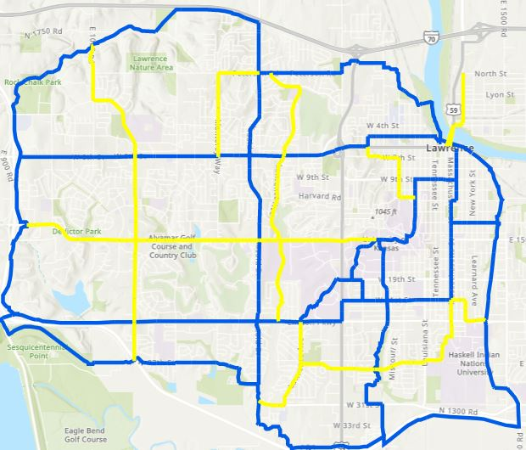
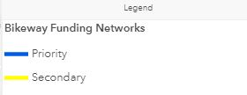
Lawrence Bikeway Plan
This map is the planned bikeway network that is part of the approved Lawrence/Douglas County Transportation Plan. The bikeway is a mix of shared use paths, bike lanes, and streets where bikes share lanes with cars. The network is a small fraction of the 1,000s of miles of Lawrence roadway.
Equity & Discrimination
Notes:
def. - long-term, systematic effort to address public health problems on the basis of the results of community health assessment activities and the community health improvement process. This plan is used by health and other governmental education and human service agencies, in collaboration with community partners, to set priorities and coordinate and target resources. A community health improvement plan is critical for developing policies and defining actions to target efforts that promote health. It should define the vision for the health of the community through a collaborative process and should address the gamut of strengths, weaknesses, challenges, and opportunities that exist in the community to improve the health status of that community.

Slide 4
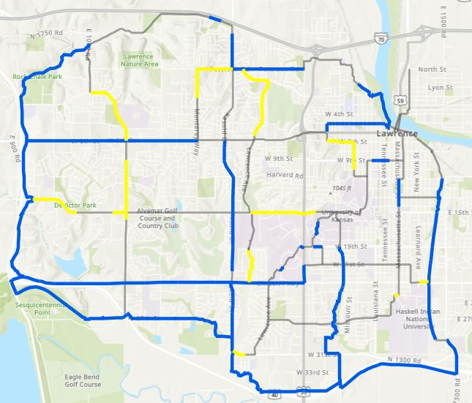
Lawrence Bikeway Plan
The blue and yellow lines represent the segments of the bikeway already built. It is still a very fragmented network, with limited connectivity (the gray lines are the planned segments). Only 58.4% of the planned network is completed.
Equity & Discrimination
Notes:
def. - long-term, systematic effort to address public health problems on the basis of the results of community health assessment activities and the community health improvement process. This plan is used by health and other governmental education and human service agencies, in collaboration with community partners, to set priorities and coordinate and target resources. A community health improvement plan is critical for developing policies and defining actions to target efforts that promote health. It should define the vision for the health of the community through a collaborative process and should address the gamut of strengths, weaknesses, challenges, and opportunities that exist in the community to improve the health status of that community.

Slide 5
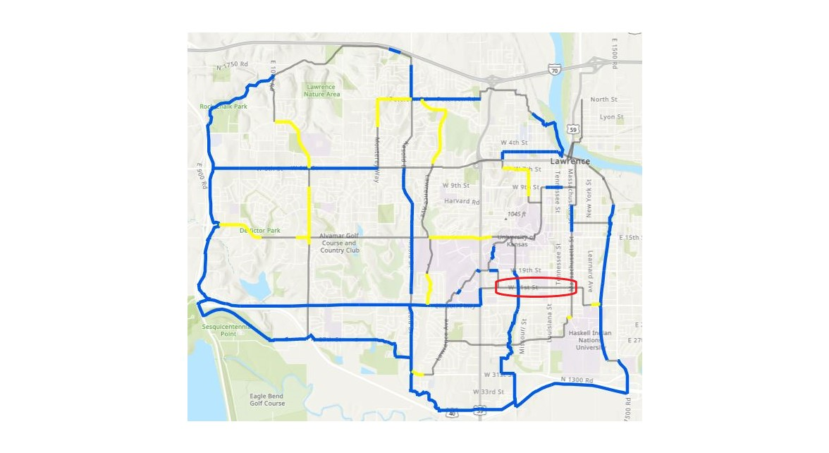
Importance of 21st Street
The importance of 21st Street in the bike network is clearly demonstrated here. By adding the “bike boulevard” on 21st Street (red oval), Lawrence would greatly enhance connectivity of the bike network, especially for east/west travel that is a challenge for people on bikes.
Equity & Discrimination
Notes:
def. - long-term, systematic effort to address public health problems on the basis of the results of community health assessment activities and the community health improvement process. This plan is used by health and other governmental education and human service agencies, in collaboration with community partners, to set priorities and coordinate and target resources. A community health improvement plan is critical for developing policies and defining actions to target efforts that promote health. It should define the vision for the health of the community through a collaborative process and should address the gamut of strengths, weaknesses, challenges, and opportunities that exist in the community to improve the health status of that community.

Slide 6
Facts about 21st and “bike boulevards”
The 21st Street bike boulevard has been approved by the Multimodal Transportation Commission which is tasked to “make recommendations to the Governing Body regarding the priority, location, and design of transportation facilities…” (City of Lawrence Resolution 7172).

Slide 7
Facts about 21st and “bike boulevards”
The 21st Street project has been approved twice by the City Commission. On July 2, 2019, the Commission approved the 21st St. project while deferring action on another bike boulevard on 13th St. The Commission felt it best to focus on one project so that there would be sufficient funding to do the project well and evaluate its effectiveness. It was approved again by the Commission on December 17, 2019, as part of the 5-year Plan for Bike/Ped Improvements (CIP# MS-20-8000 to MS-24-8000).

Slide 8
Facts about 21st and “bike boulevards”
Funding for this project will come from approved Capital Improvement Plan project budgets that are dedicated to “stand alone” bike/ped projects:
$258,144.05 2018 Sidewalk/Bike/Ped Improvements bond (CIP# CI09)
$ 73,000.00 2020 Sidewalk/Bike/Ped Improvements (CIP# MS-20-8000) approved 12/17/19
$ 66,072.93 2020 Sidewalk/Bike/Ped Improvements (CIP# MS-20-8000)
**These funds are not to be used for general roadway and sidewalk maintenance.**

Slide 9
Facts about 21st and “bike boulevards”
The low bid for construction of the 21st Street bike boulevard is $397,216.98. This is about $66,000 over anticipated costs. Well over half of this cost ($258,144.05) would be financed by a 2018 Sidewalk/Bike/Ped Improvements bond. The total cost for this project, which runs all the way from Ousdahl to Massachusetts, is a very small fraction of the cost for a typical roadway project of this length and magnitude.

Slide 10
Facts about 21st and “bike boulevards”
There is some concern this is a “watered down” version of the originally-proposed project. There have been some modifications, but the existing plan is very similar to what was presented to the City of Lawrence in early 2019. The design was created by Alta Planning + Design, a nationally-recognized leader in transportation planning, design, and implementation.

Slide 11
Facts about 21st and “bike boulevards”
The project will benefit all roadway users, not just cyclists. A “bike boulevard” is simply a roadway designed to decrease the amount and speed of automobile traffic. This makes it safer for people on bikes, but also for people in cars and on foot. It is true that “speed kills,” so creating a calmer street is good for all roadway users and people in the neighborhood (and students at Lawrence High adjacent to 21st Street).

